Slide 1
ankita pralhad thorushe enroll no- ebeon0921446413 batch – 6141 project name – placement management system

Slide 2
Content
1.Problem Statement
2.Introduction
3.Features
4.Objectives
5.System Requirements Specification
6.Output
7.Advantages
8.Conclusion

Slide 3
Problem Statement
The existing system is doing all the processes manually. The Admin should refer all the records kept for years ago to simply no details. This is complex and time consuming. This process is so difficult when the number of users increases. There are a lot of limitations for the existing system.
To overcome this problem, We have come up with this project that is, “Placement Management System” Using Computer based application.

Slide 4
Introduction
We have developed this Java Spring Boot Project on Placement Management System for automating the process of Placement Management System. The main features of this project is to manage Applicants, Jobskeers, Jobs, Companies . The main modules of the project is Admin module, Student module, Recruiter module.
Notes:
A

Slide 5
Features
The system is an online application that can be accessed throughout the College Admin ,Recruiters & Students with proper login provided.
It contains mainly Three modules.
1.Admin Portal– To maintain the college information and the placed and non placed students list.
2.Student Portal– It contains all the information about students. Each student have their own portal ,Where then can apply for particular job which can be uploaded by company recruiter.

Slide 6
3. Recruiter Portal – This portal is for company person who are going to upload all the jobs for particular designation for their company , Also they can check the applicant list , view their resume , shortlist them on the basic of qualification and experience, update their job status.

Slide 7
Objectives
Help in fast access procedures in placement related activities.
The facility of maintaining the details of the placed and non-placed students.
The proposed system intends user-friendly operations which may resolve ambiguity.
Time saving.
Easily finding the job vacancies which are uploaded by company recruiter.

Slide 8
System Requirents specification
SOFTWARE REQUIREMENTS
Frontend : Html, Css, Javascript
Backend : Spring Boot, Thymeleaf, JPA
Database : MySql 8
Operating System : Windows 10

Slide 9
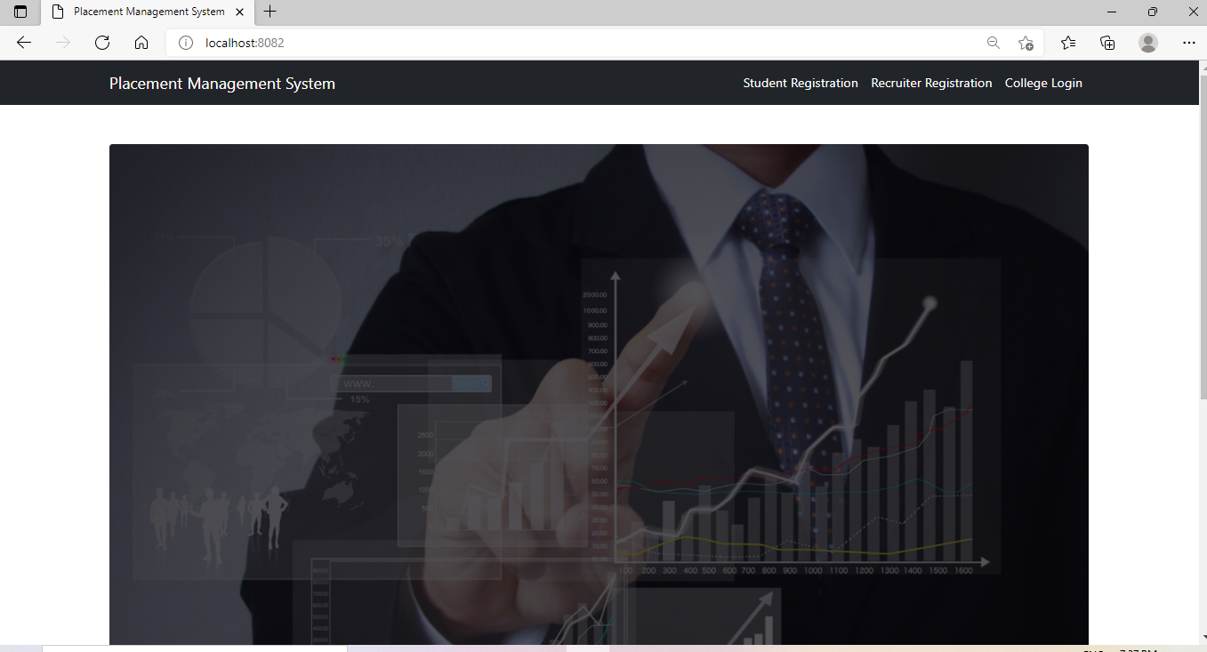
Output
Home Page :
Fig 1- Home Page

Slide 10
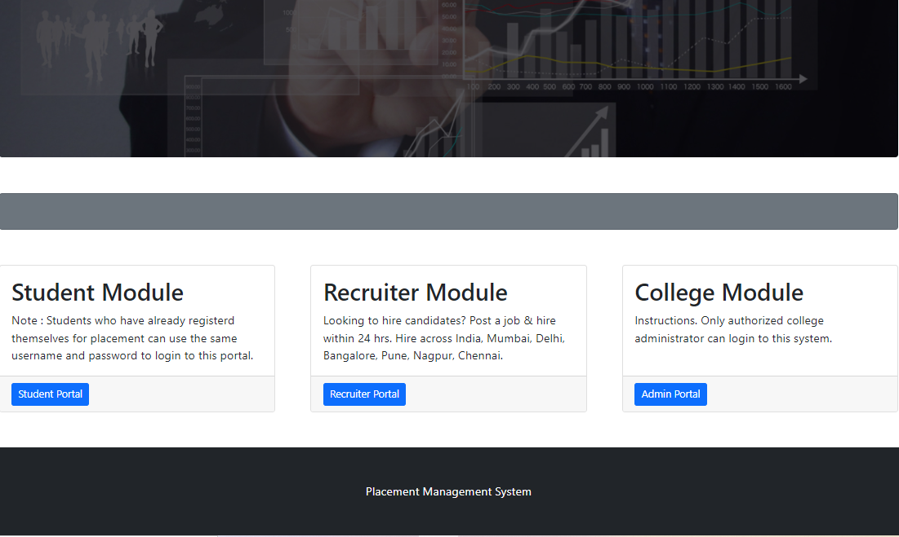
There are 3 modules : a. Admin b. Student c. Recruiter
Fig 2- Modules

Slide 11
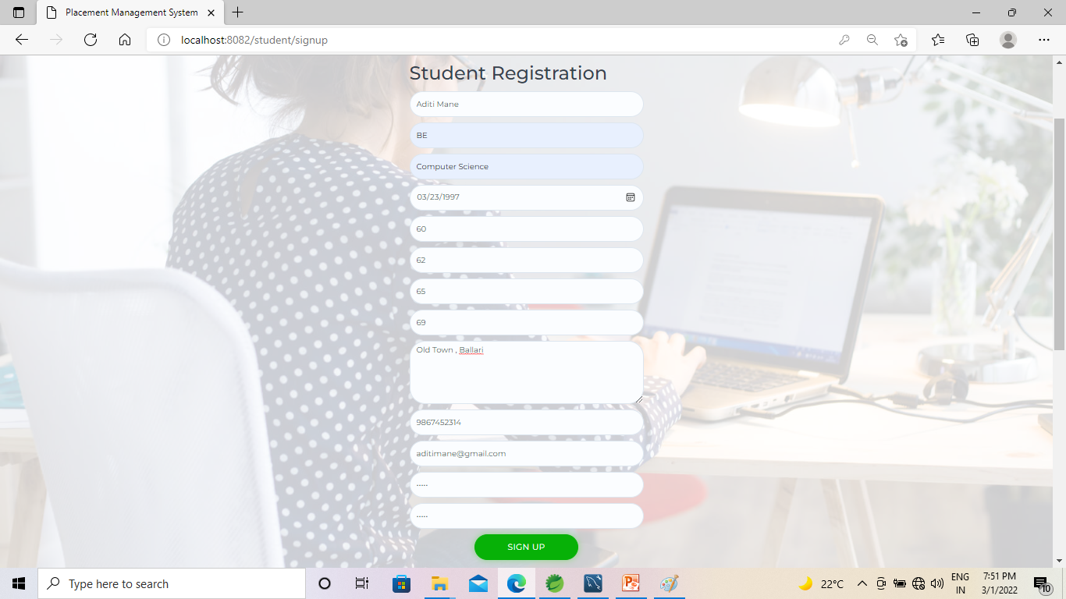
.
Student Sign Up page for Login : We should to enter all information for the sign up.
Fig 3 – Student Sign Up

Slide 12
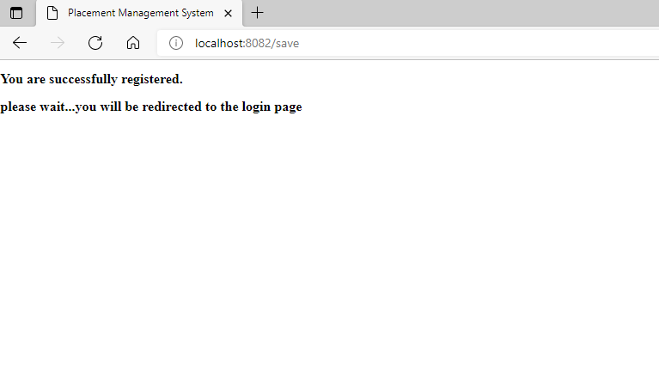
After Successfully sign up you will get this message
that “You are successfully registered.”
Fig 4 – Student Registration Message

Slide 13
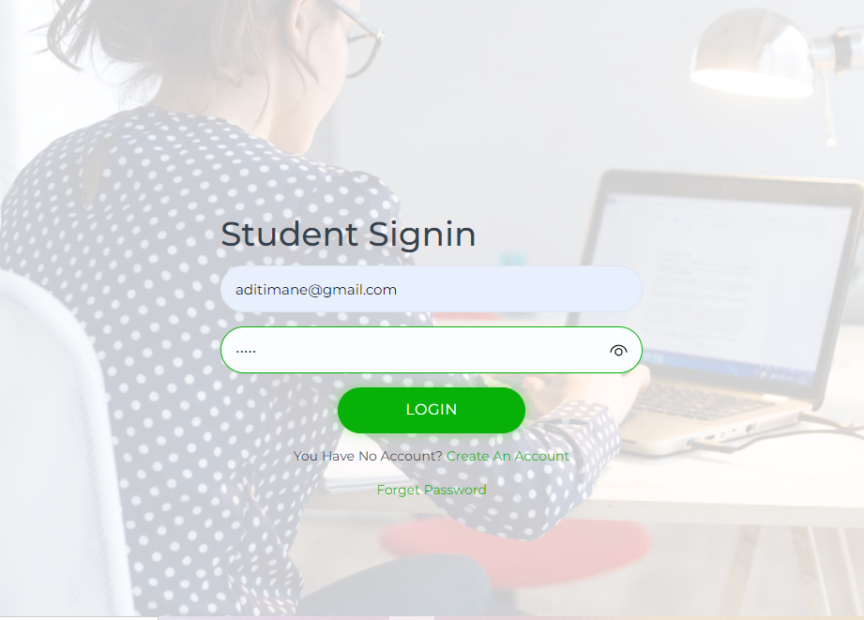
Student Sign-In : Where particular student can sign in to his portal using his User-Id and Password.
Fig 5 – Student Sign-In Page

Slide 14
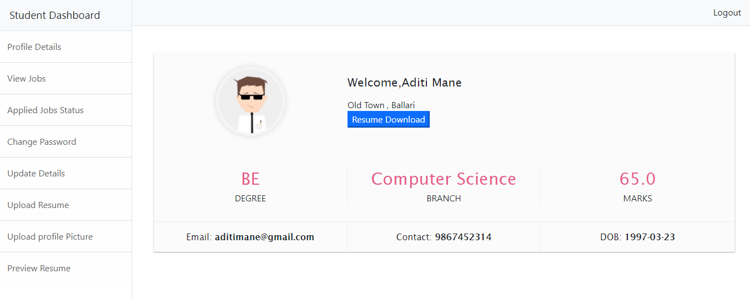
Student Portal : Where students can upload their all information to apply for jobs.
Fig 6 – Student Portal

Slide 15
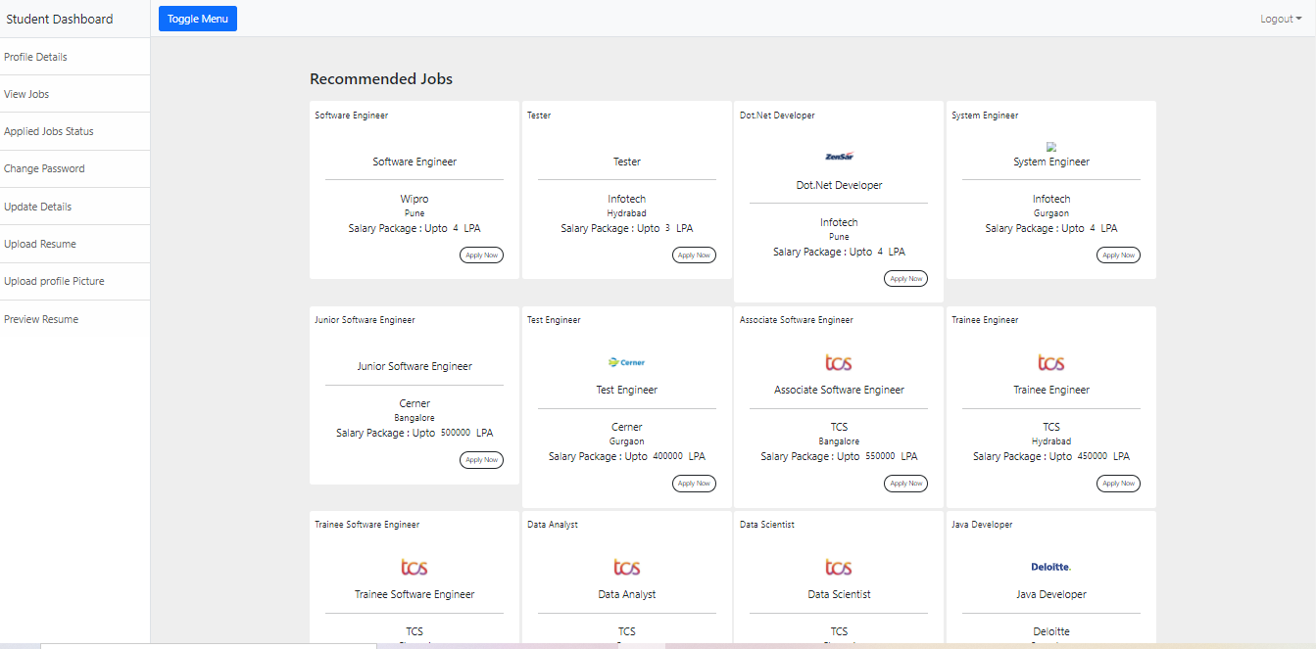
View jobs : To check the job vaccines and to apply for jobs.
Fig 7 ; View Jobs Field

Slide 16
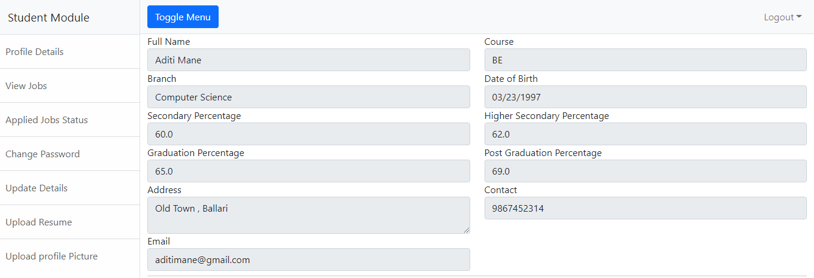
Update Details : If you want to change or update any information then you can use this field.
Fig 8 : Update Field

Slide 17
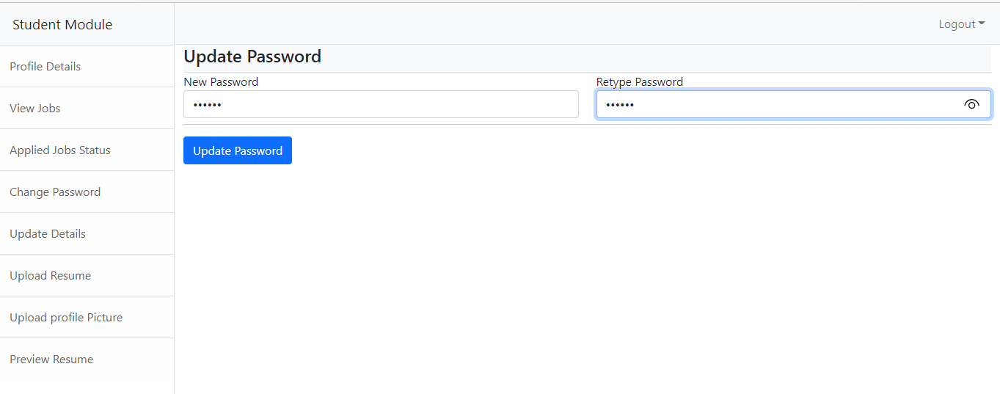
Update Password : If want to change password then you can use this field
Fig 9 : Update Password

Slide 18
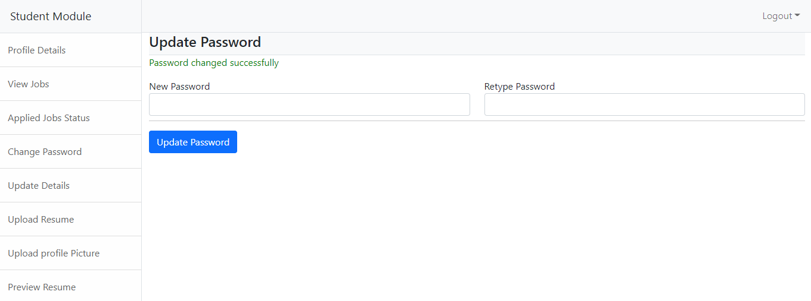
Password Updated Message
Fig 10 : Password Updated Message

Slide 19
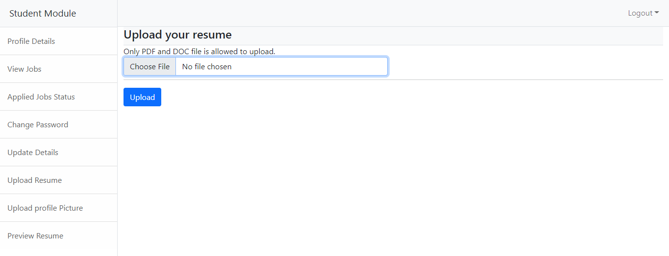
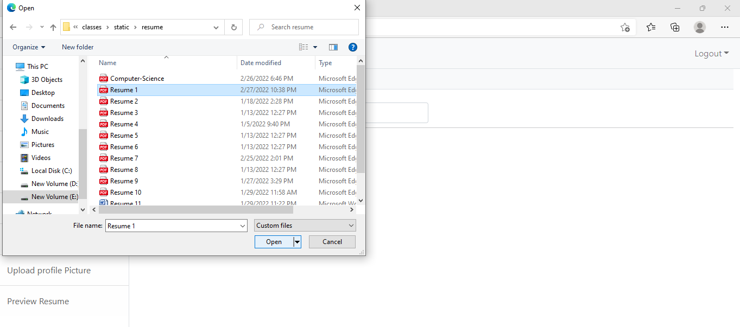
Upload the resume so recruiter can view it.
Fig 11 : Upload Resume
Fig 11.1 : Select The File

Slide 20
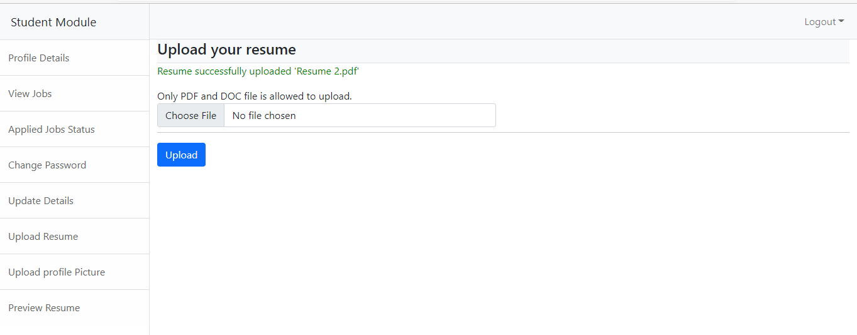
Resume uploaded and you can also see the document name that successfully uploaded.
Fig 12 : Resume Uploaded Message

Slide 21
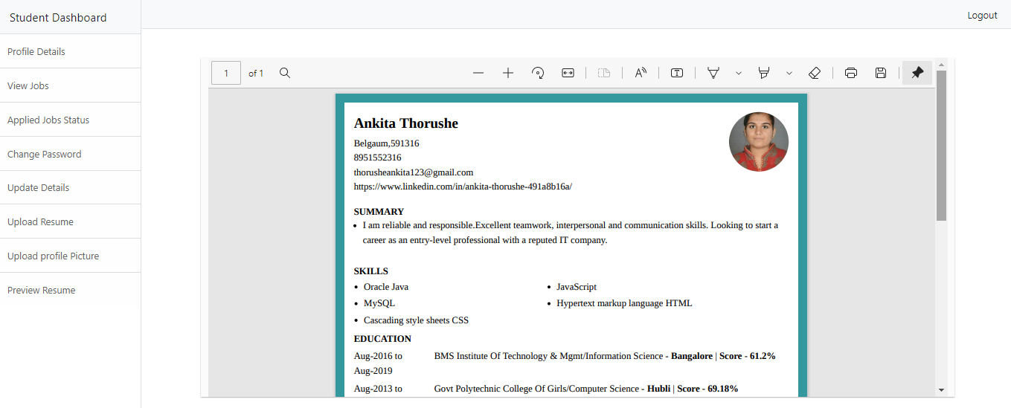
Preview Resume : You can view your resume . Which you have uploaded on your portal
Fig 13 : Preview Resume Field

Slide 22
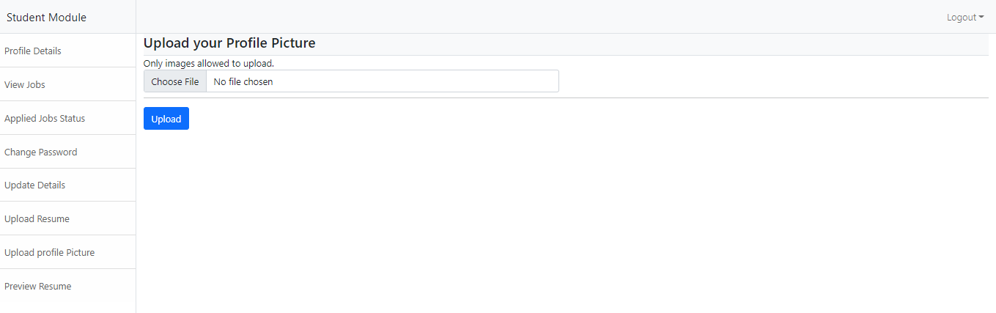
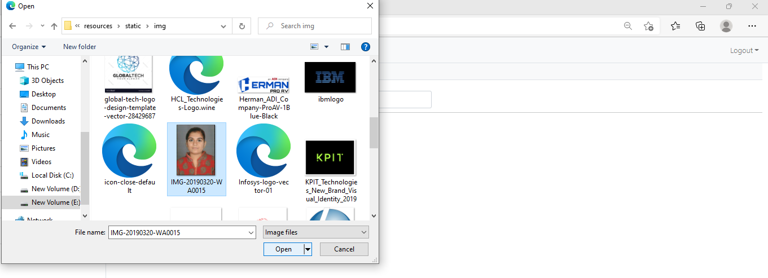
Upload Profile Picture
Fig 14 : Upload Profile Pic
Fig 14.1 : Select Picture

Slide 23
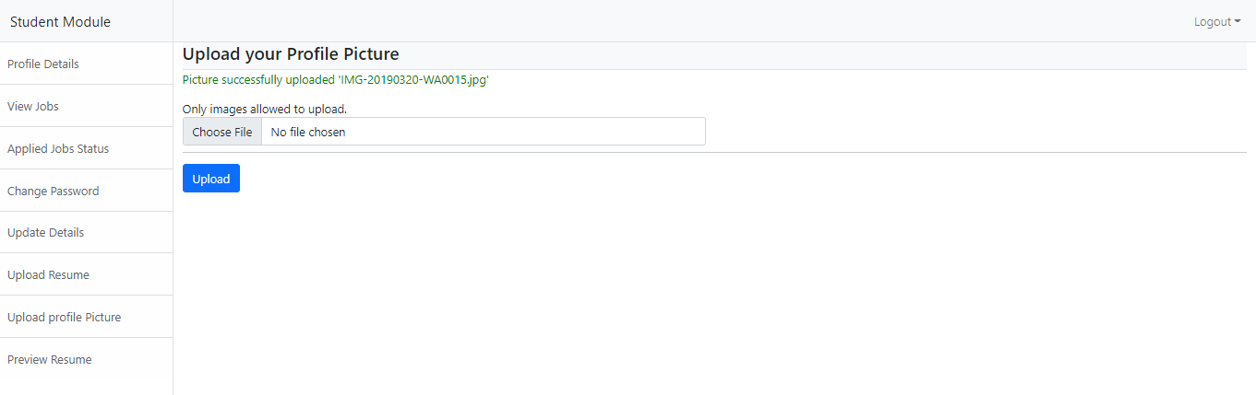
Profile Picture Uploaded Message
Fig 15 : Profile Picture Uploaded Message

Slide 24
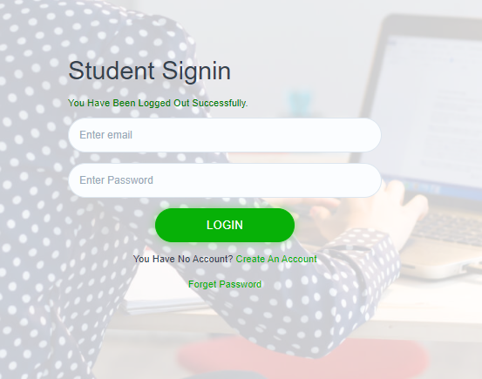
Student Logout
Fig 16 : Log-Out

Slide 25
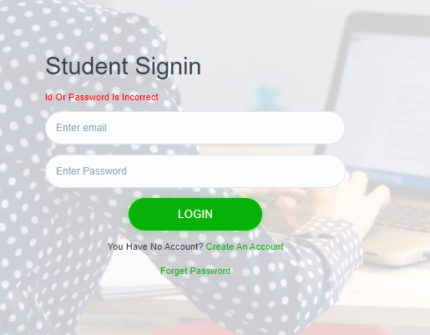
Wrong User-Id and Password : If you gave wrong Id or password then you will get this notification.
Fig 17 : Wrong Id or Password

Slide 26
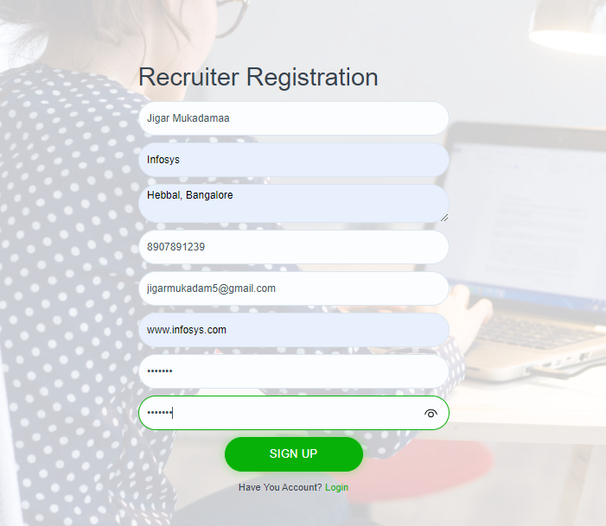
Recruiter Registration : It will ask all the information for registration.
Fig 18 : Recruiter Registration

Slide 27
Recruiter Registration Message
Fig 19 : Recruiter Registration Message

Slide 28
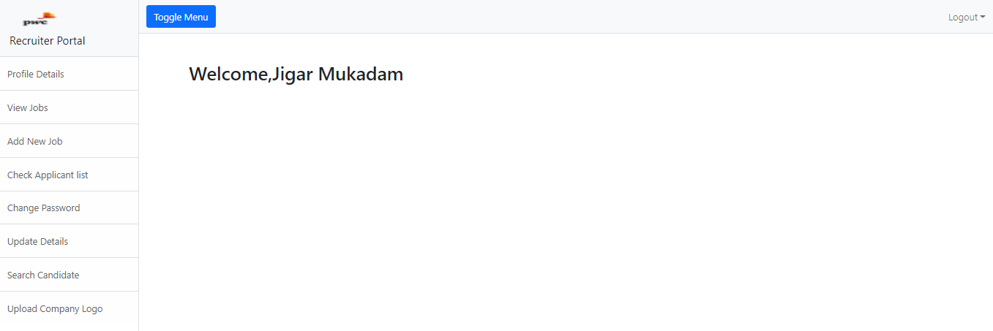
Recruiter Portal
Fig 20 : Recruiter Portal

Slide 29
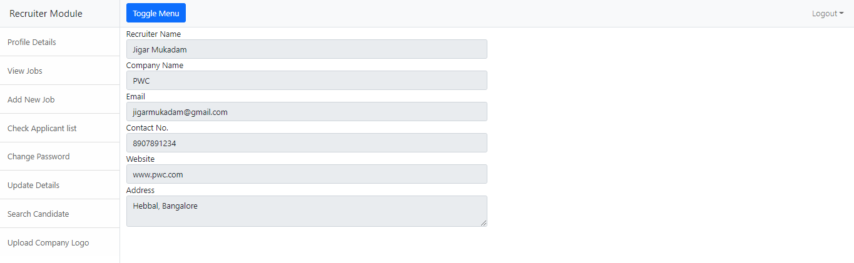
Profile Details of Company Recruiter.
Fig 21: Recruiter Profile

Slide 30
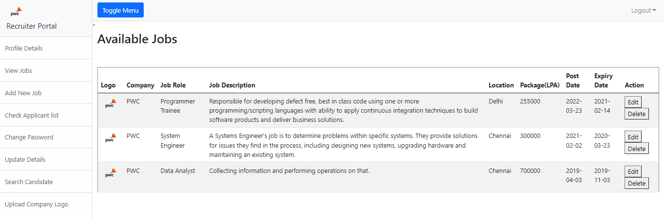
View Jobs : This field for recruiter to view job openings.
Fig 22 : View Jobs

Slide 31
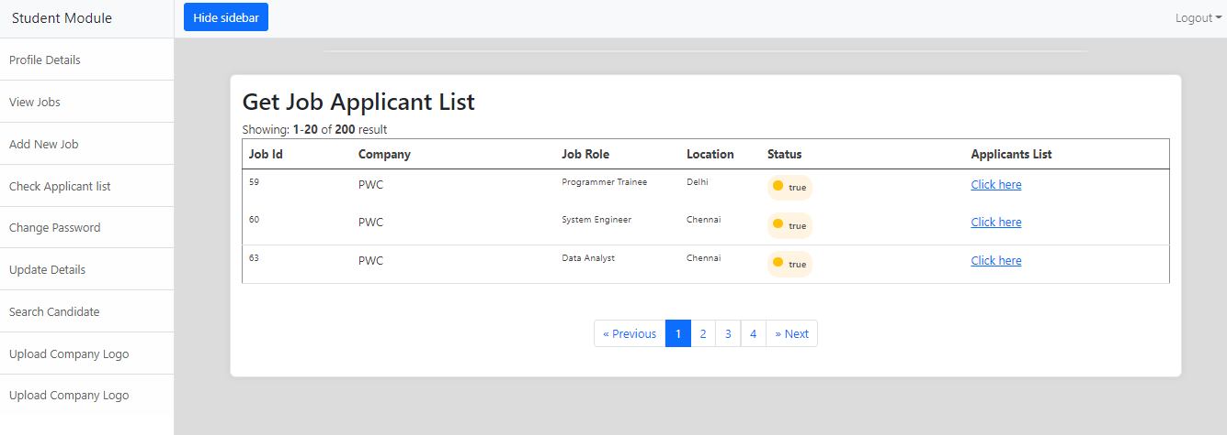
Applicant List
Fig 23 : Applicant List

Slide 32
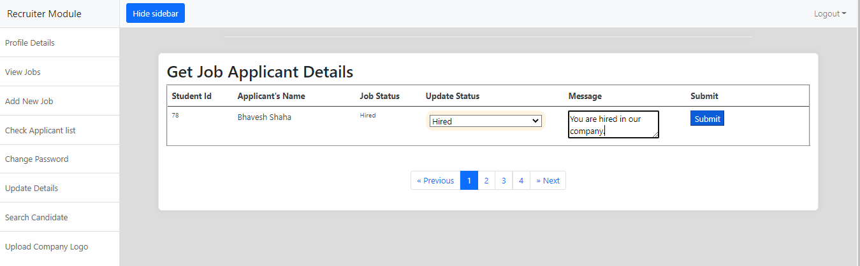
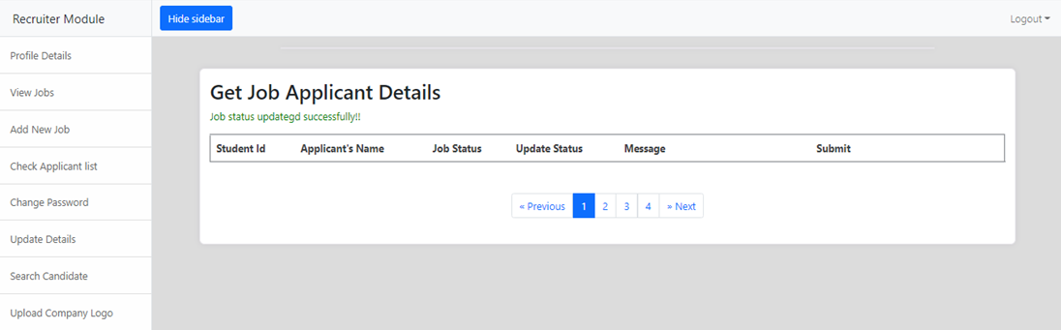
Recruiter updating the applicant job status.
Fig 24 : Updating Job Status
Fig 24.1 : Job Status Updated Message

Slide 33
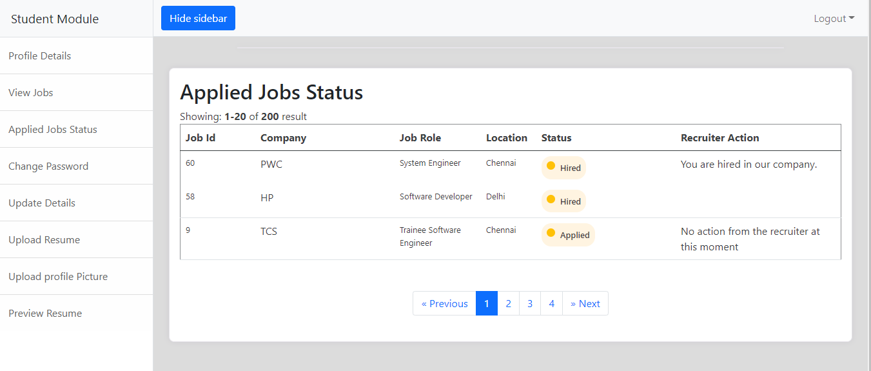
Job status you can see on particular student portal.
Fig 25 : Job Status & Recruiter Action

Slide 34
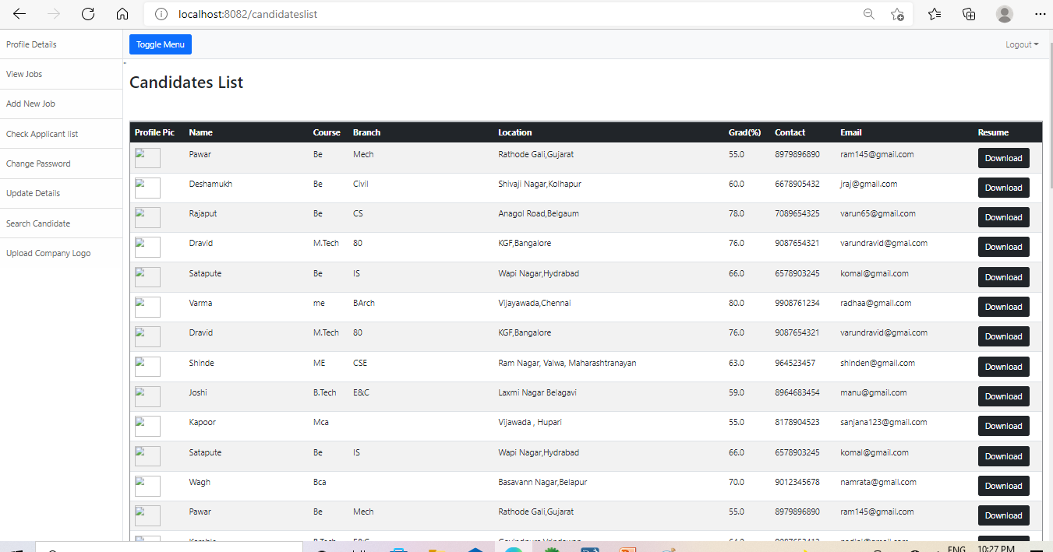
Search Candidate List who have logined on student portal.
Fig 26 : Candidates List

Slide 35
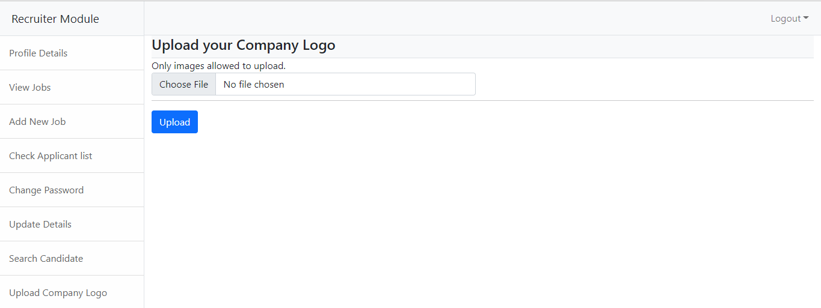
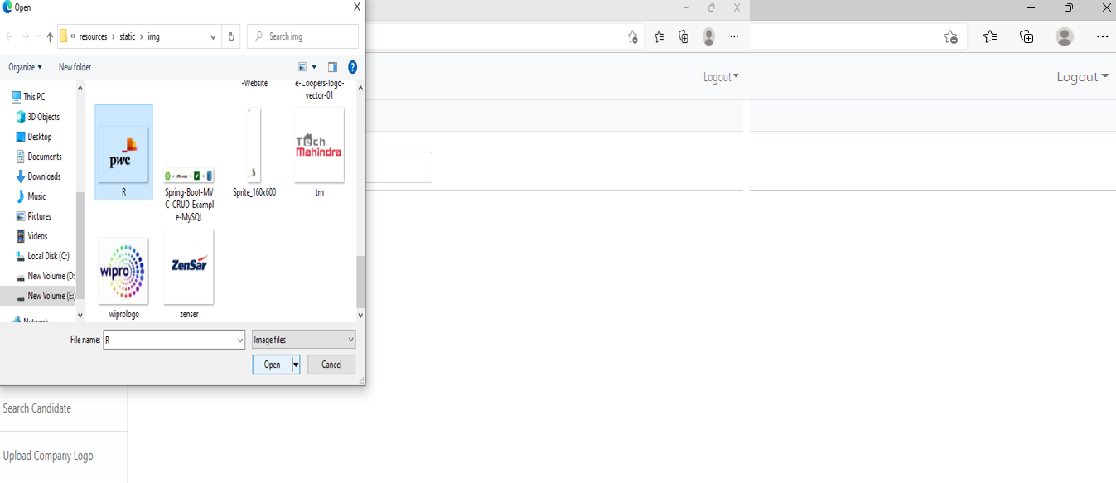
Upload Company Logo
Fig 27 : Company Logo
Fig 27.1 : Select Logo Pic

Slide 36
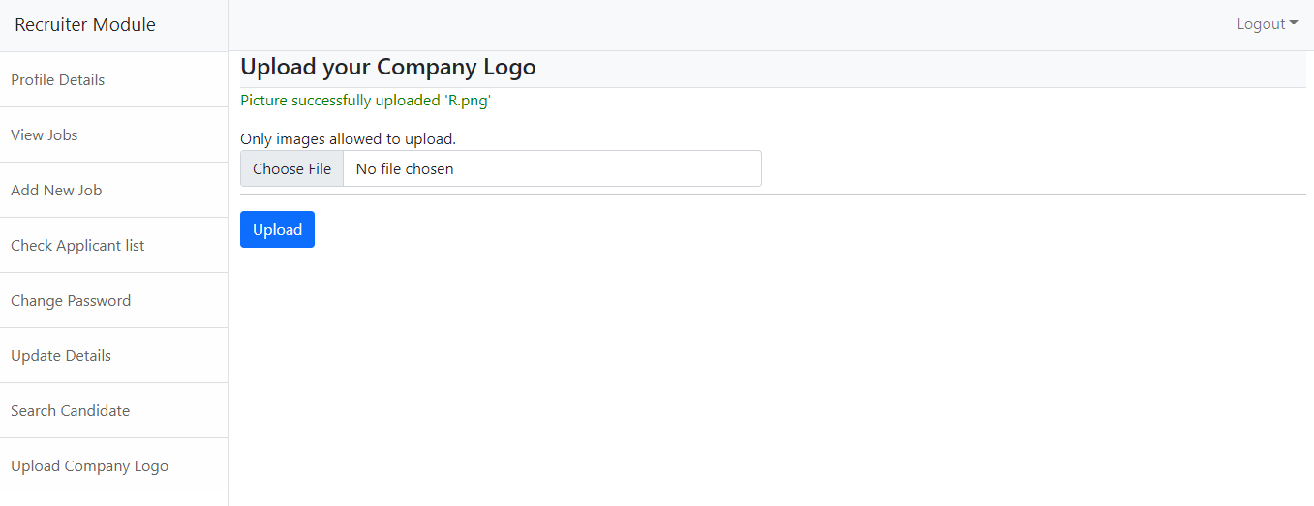
Company Logo uploaded message.
Fig 28 : Company Logo Uploaded Message

Slide 37
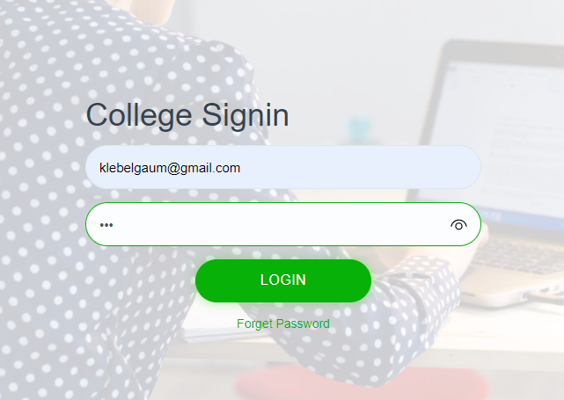
Admin Login
Fig 29 : College Log-In

Slide 38
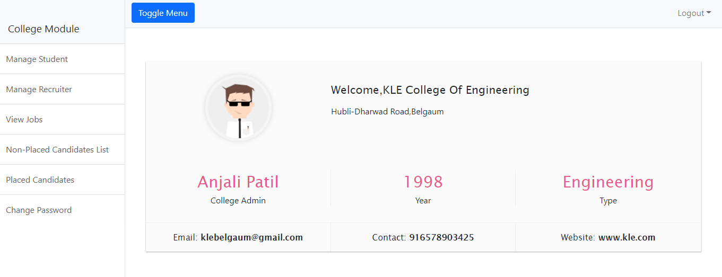
College Portal
Fig 30 : College Portal

Slide 39
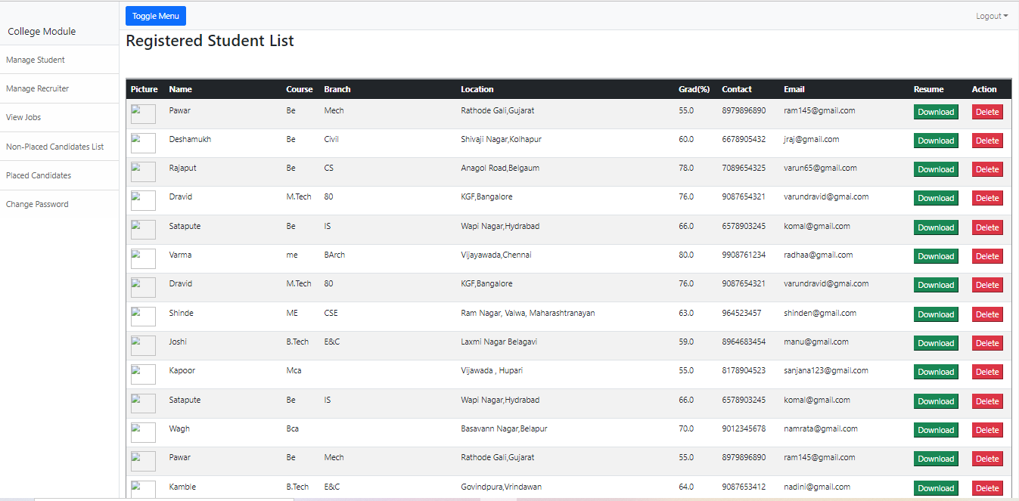
Student List who have registered on portal.
Fig 31 : Registered Student List

Slide 40
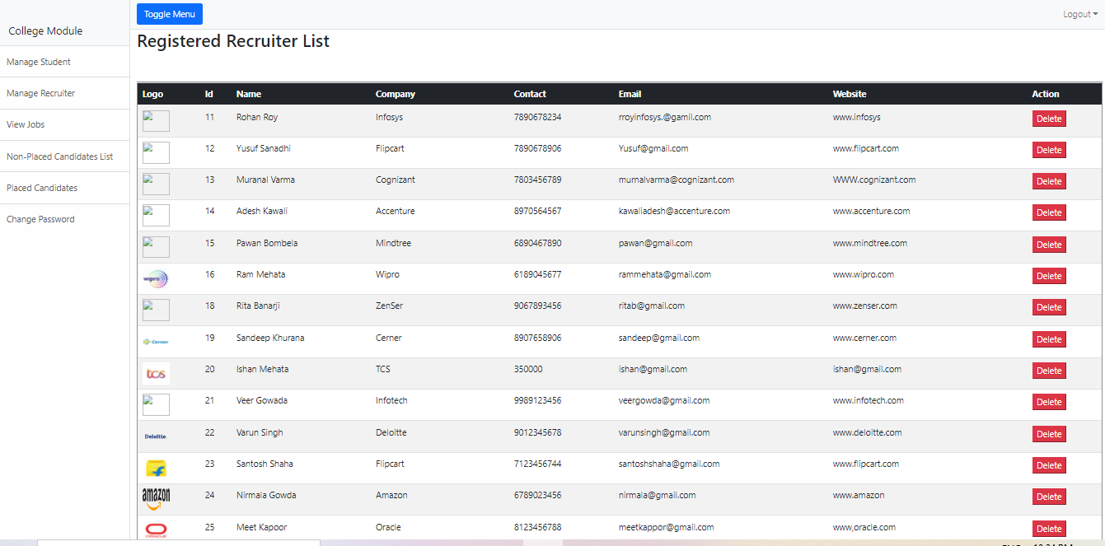
Company recruiter list who have registered on portal.
Fig 32 : Registered Recruiter List

Slide 41
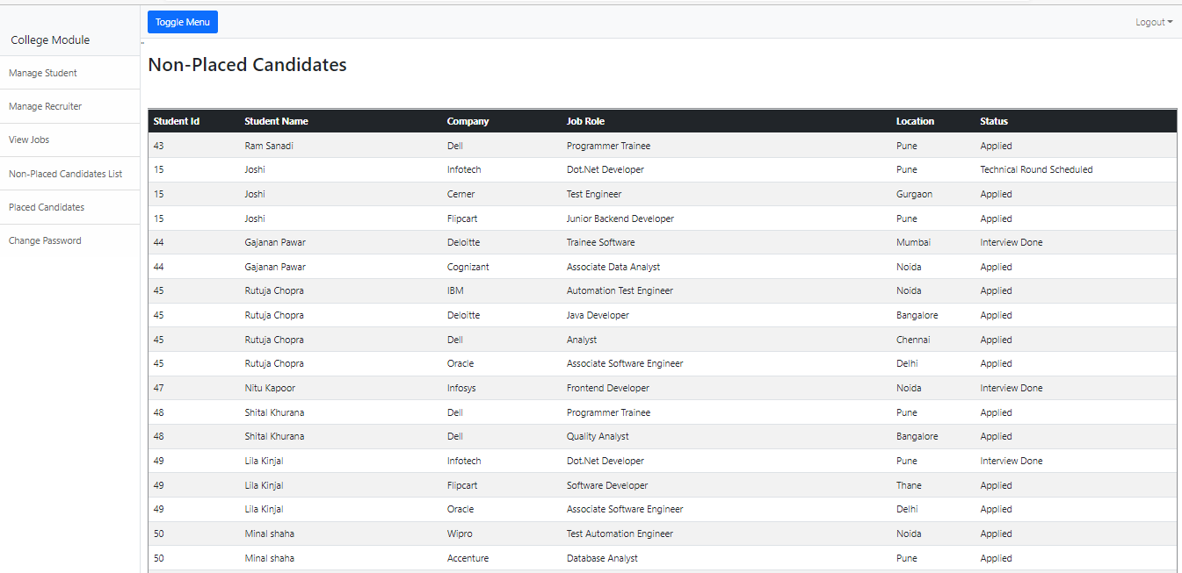
Non-Placed Candidate List
Fig 33 : Non-Placed Candidate List

Slide 42
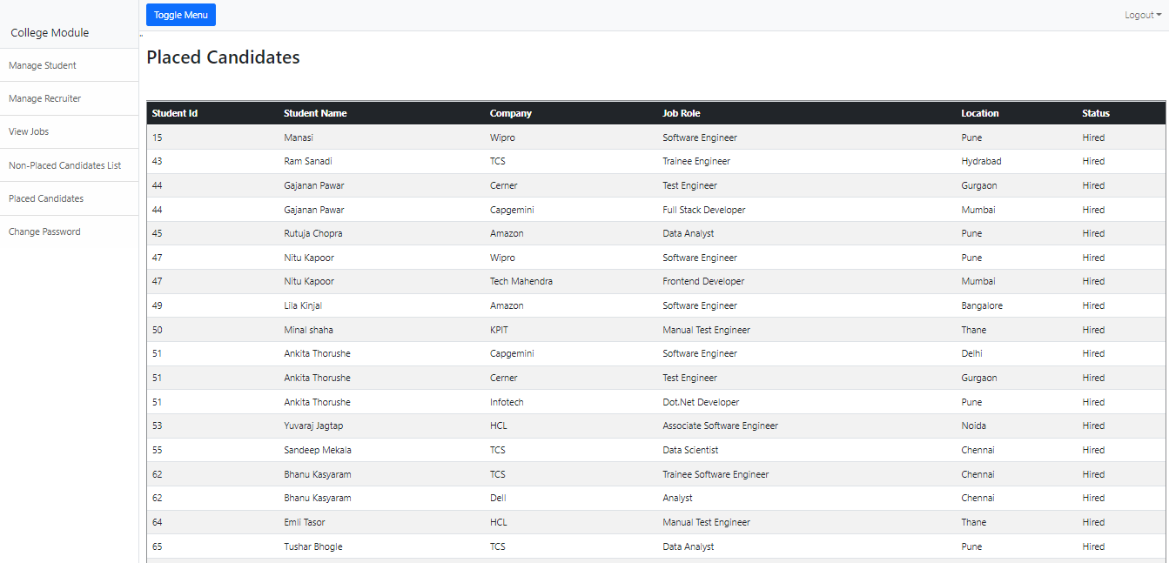
Placed Candidates List
Fig 34 : Placed Candidates List

Slide 43
Advantages
1. Improve student placement & retention.
2. Administrative control over students and companies.
3. Identify companies that match student’s expectations.
4. Online Portal: Students can apply for companies online.
5. Time-Saving: Reduces manual human effort.
6. Easy-to-use.
7. Highly Secure and Reliable.
8. The facility of maintaining the details of the students.

Slide 44
Conclusion
Comparing to existing computerized system, it performs at a faster pace. System gives better feedback. Accurate information is available. Provides security to the system & software. Forms are very user friendly. Admin can view for which company student registered. So at last we conclude that this Project will be useful to several Students to search for better jobs and Search for Companies according to their convenience.

Slide 45


